Slide 1



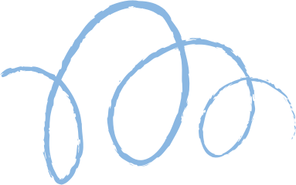









Solving Non-Linear Equations Using Four Classical Root-Finding Methods

Slide 2

Team Info
Team Leader
C221046
Mamun Mahmud
Member 1
Member 2
Member 3
C221060
Md Najmus Sakib Rafi
C221044
Md Jobayer Hossain
C221050
Md Rayhan Uddain

Slide 3
Introduction
Root-finding is a cornerstone of computational mathematics, often vital when analytical solutions are out of reach. This project offers a concise but powerful demonstration of four classical methods—Bisection, False Position, Secant, and Newton-Raphson—implemented in a modern React application. By merging theoretical insights with an interactive, visual approach, it serves both educational and analytical purposes.

Slide 4

01.
Multi-Method Solver
02
Graphical Visualization
Features
03
Initial Guess Handling
04
StepwiseTabular Solution
05
Method Comparison
06
Guidance and Validation
07
Equation Input and Parsing
08
Responsive Interface

Slide 5



Frontend
Built with React.js
Algorithms
Modular implementation of Bisection, False Position, Secant, Newton-Raphson.
System Architecture
Equation
:User-supplied strings are parsed and safely evaluated (e.g., with math.js).
Comparison Module
Gathers results for a summary view
Plotting
Visualizations are generated (using Chart.js) to plot functions and highlight roots and initial points.

Slide 6
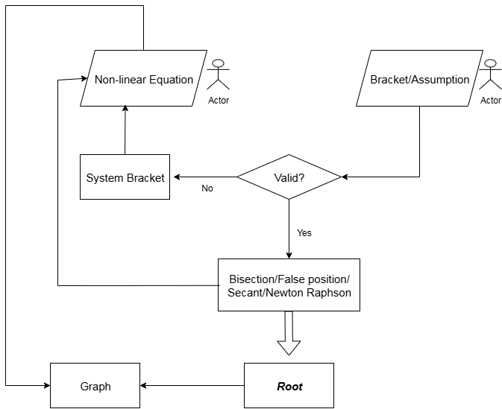
Flow Chart

Slide 7
Four Methods
Bisection
False position
Repeatedly halves a bracketed interval where the function changes sign.
Converges reliably but can be relatively slow
Uses a secant line between two bracket points to find where the function crosses zero.
Maintains a bracketed approach, often converging faster than bisection.
Sectant Method
Newton Raphson
Estimates the next root by drawing a secant line between two recent approximations.
Eliminates the need for derivative calculations but can be less stable.
Uses derivatives to iterate from an initial guess directly toward the root.
Tends to converge rapidly but requires a good starting value and derivative availability.

Slide 8
Automated Bracket
To robustly determine a bracket (interval endpoints) that contains a root for bracketing methods, the system programmatically explores the function’s domain in both directions using an exponential step search.
Because the increment doubles at each iteration (exponential search), this algorithm achieves O(log n) time complexity

Slide 9
User input
Equation string, initial guesses/bracket
01.
Example Case Study
Iteration
Each method solves for the root, displaying a step-by-step table and updating the graph.
02.
Comparison
Roots and iteration numbers for all methods are summarized in a table below.
03.

Slide 10
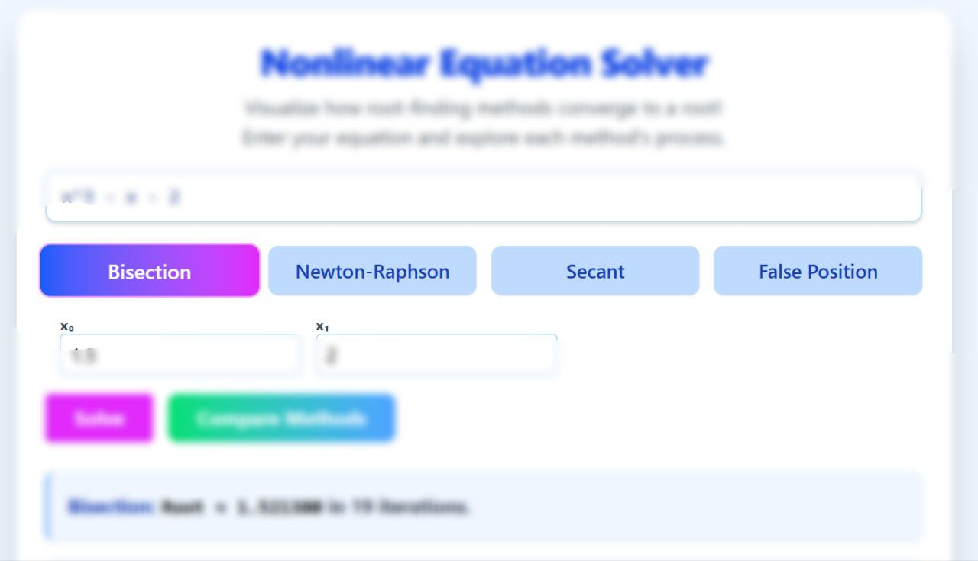
Multi-Method

Slide 11

Equation Input

Slide 12
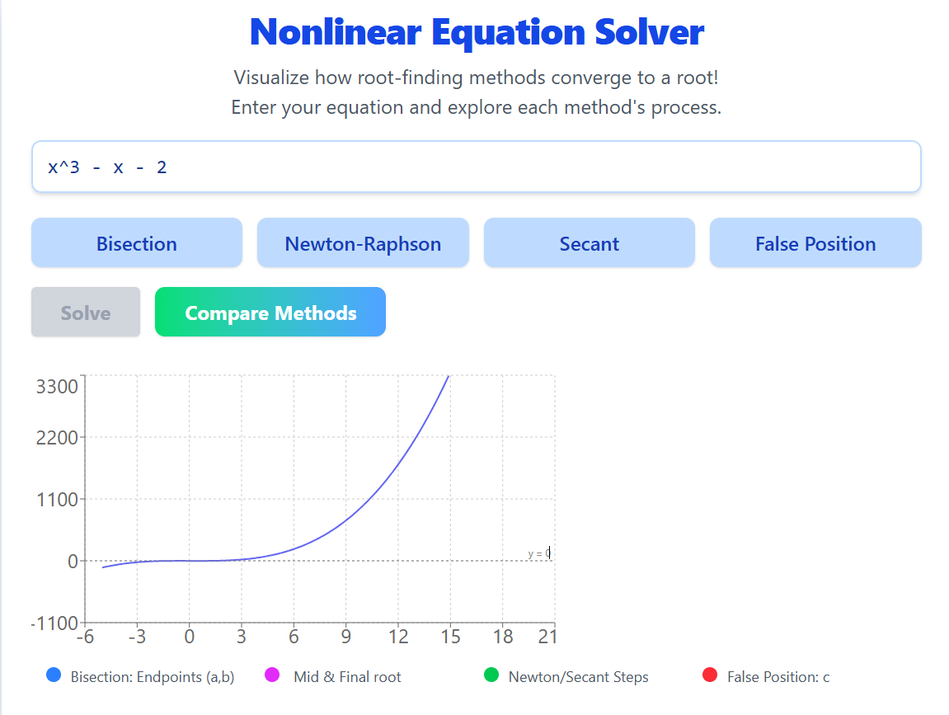
Graphical Visualization

Slide 13
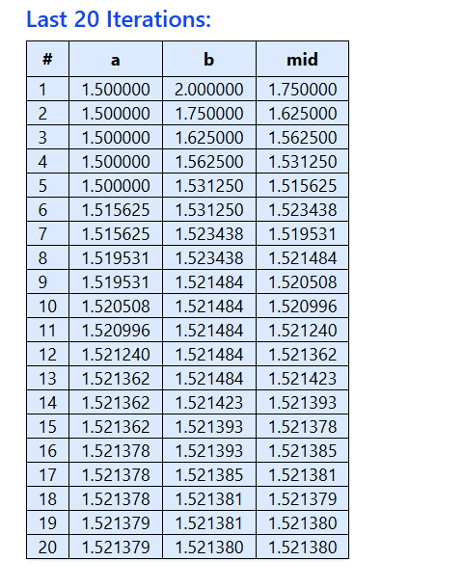
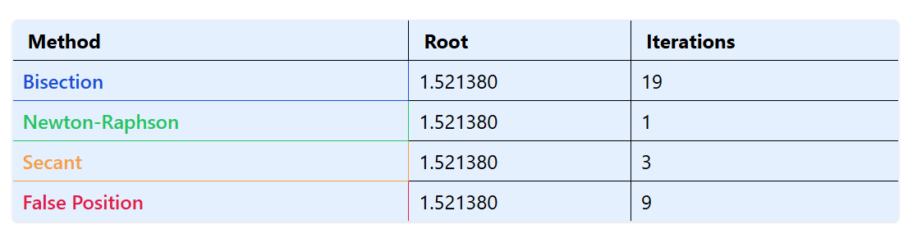
Iterations
Method Comparison

Slide 14
Conclusion
This React-based platform highlights the convergence and performance nuances among four classical root-finding methods, employing interactive visualization, automated bracketing, and comparative analytics. Its modular design fosters reliability, scalability, and deeper insight, marking it as a versatile educational and practical tool for non-linear equation solving.

Slide 15

Any Question

Slide 16
Thank you very much!

